Slide 1
Cognitive Robotics Presentation
Paper 6: The eye in hand: predicting others’ behaviour by integrating multiple sources of information
Michael Peres

Slide 2
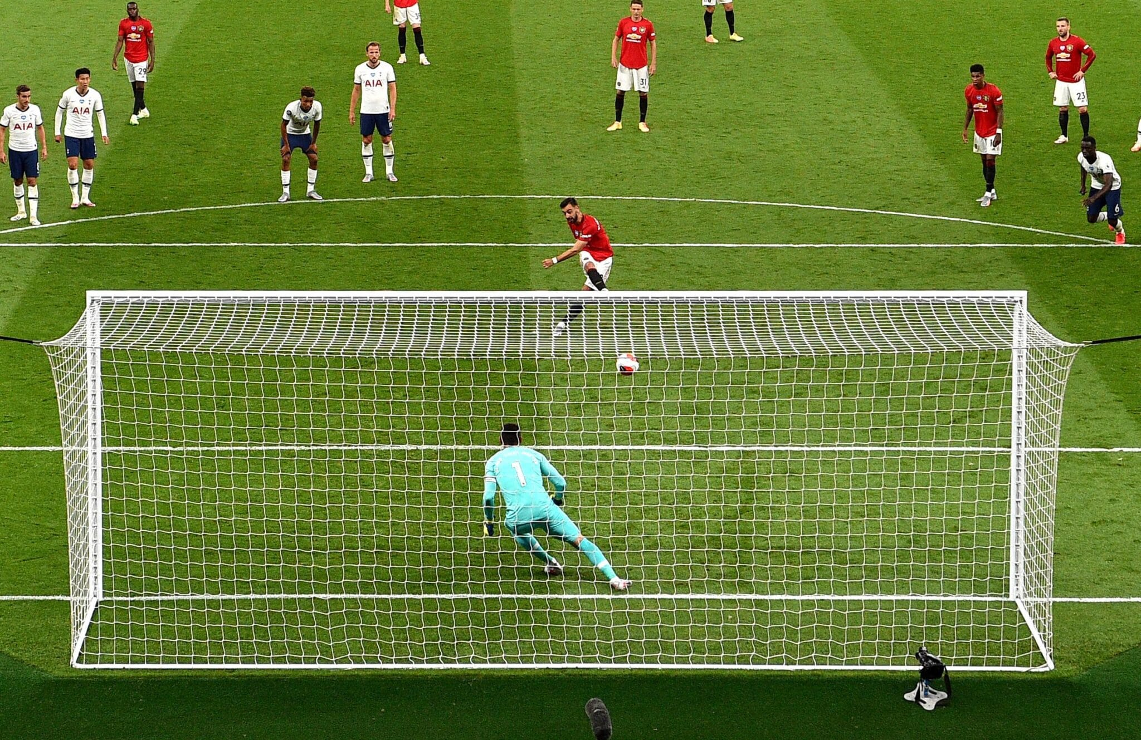
1) Description of Original Study
How do we predict the goal of another person as a human?

Slide 3
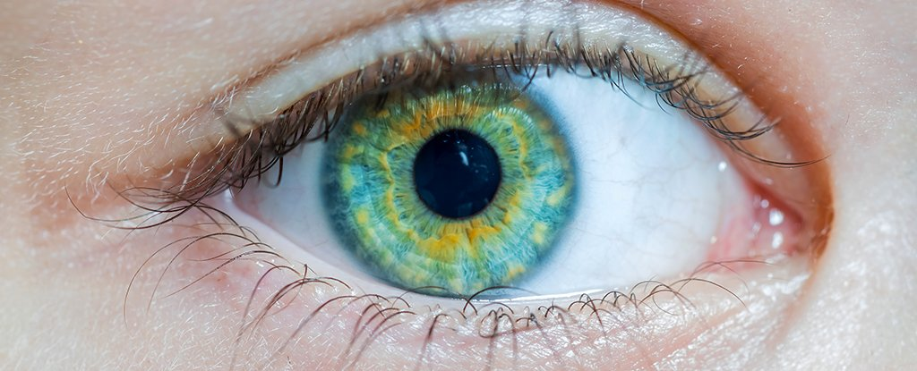
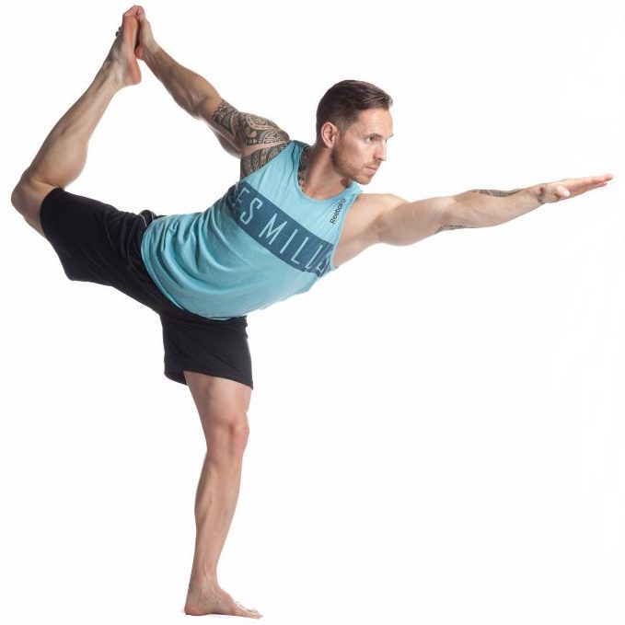
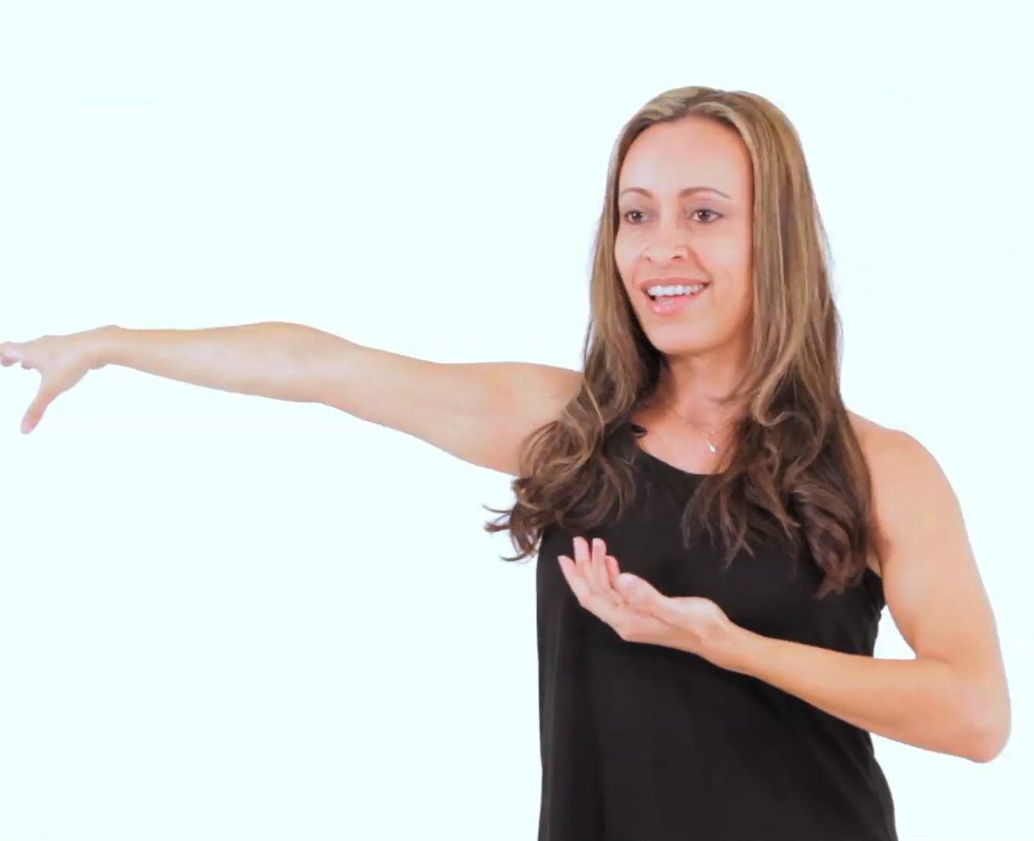
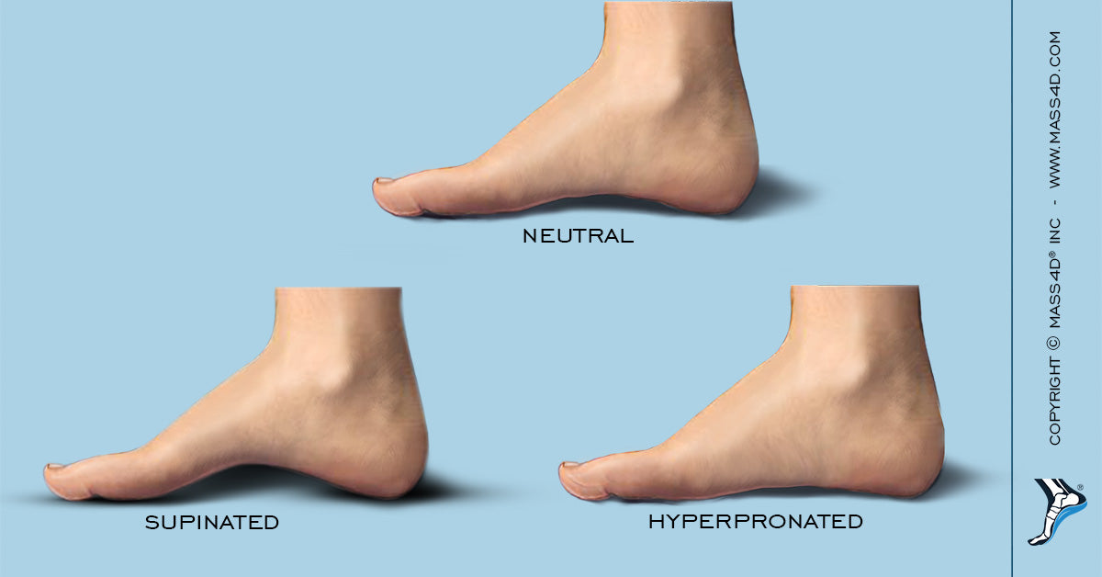
1) Description of Original Study
What information do we use to make our assumption?
Which source of information do we favour more?

Slide 4

1) Description of Original Study
Predict whether the woman will pick up left or right object.
Gaze Direction
Arm Trajectory
Hand Pre-shape
Goal
Main objective: Unknown in human processing is understanding how each information contributes to goal though process.
Notes:
The paper aimed to do just this, understand how people determine whether someone has a goal or not.
In this goal, the user had to use 3 sources of information to determine whether she was going to reach for the left or right object.

Slide 5
1) Description of Original Study
Goal of Paper
Experiment 1: Which source of information participants value the most for obtaining actions?
Experiment 2: Whether there is a difference in how these values are updated while unfolding of the action, sensitivity of information.

Slide 6
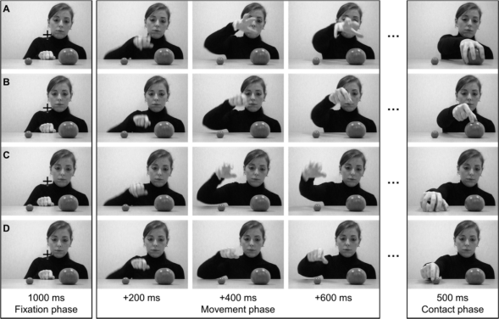
1) Description of Original Study
Type of Data Records in Dataset
Gaze | Hand Pre-shape
Congruent | Congruent
Congruent | In-Congruent
In-Congruent | Congruent
In-Congruent | In-Congruent
Notes:
In the experiment mentioned in the paper used, users were told to determine the goal of the user at different periods, and there were 2 different experiments performed using this dataset to obtain the users goal prediction, including tracking mouse and eye movements.

Slide 7
1) Description of Original Study
Experiment 1
Conclusion
Experiment 1: Which source of information participants value the most for obtaining actions?
It shows that based on this metric, the effect of hand preshape aided in earlier gazing of the correct target goal. The model determined that when conflicting sources was used then participants gazed at video interaction gaze for aid, however in cases where preshape was congruent, participants were faster and more accurate regardless of the information provided by the actor’s gaze.
In the first experiment, we tried to find out which sources of information participants value the most in the goals, it concluded that the most viewed thing was looking at the videos gaze.
Using the metric of gaze arrival times mentioned in the paper metrics, (the time of getting to goal AOI subtracted to final frame ending).

Slide 8
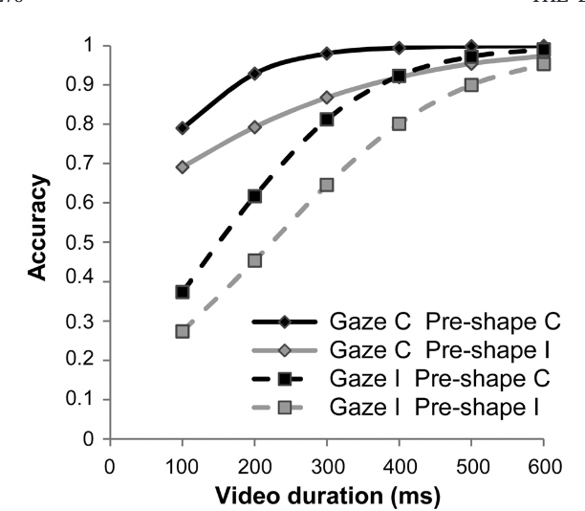
1) Description of Original Study
Experiment 2
Conclusion
Experiment 2: Whether there is a difference in how these values are updated while unfolding of the action, sensitivity of information.
This is supported by the evidence showing that when the hand preshape correctly cues the actor’s goal and/or the video duration increases, the information provided by the gaze decreases.
Experiment 2 show that, for longer videos, the importance lowers for gaze and rises for arm trajectory.
It was understanding whether these source of information weightings were constant or not.

Slide 9
1) Description of Original Study
Results and Final Points of Paper
Preshape was one of the main features even though reliability was 50%, and participants acted on their prior beliefs about precision of a source.
As time progressed, participants relied more on arm movements such as arm trajectory.
Over time of the experiment, actor’s gaze was less reliantly used for accuracy, and was modulated by learning.
Gaze information is only able to effect predicted outcome only when no other information about intention is provided.

Slide 10
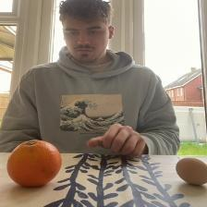
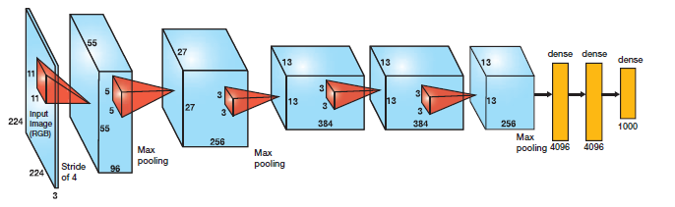
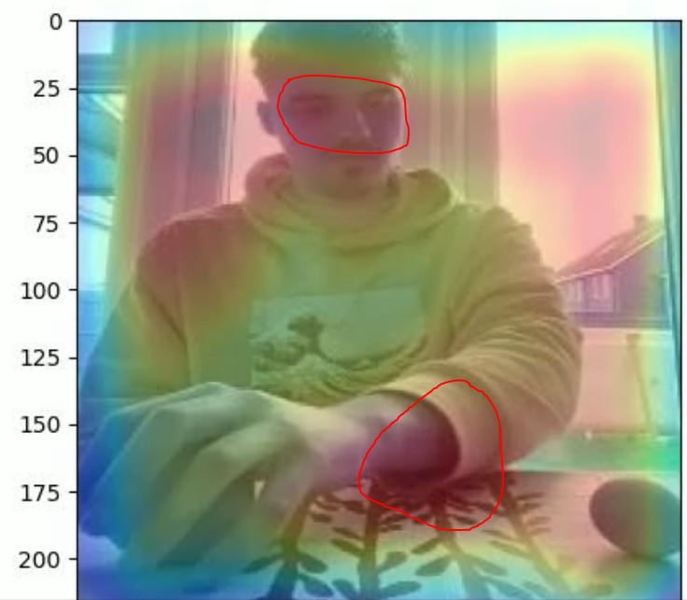
2) Description of Computational Model
Aim of implemented computational model.
Output:
Goal is LEFT
Goal is RIGHT
Custom Made Alex Net for visualising kernel features.
Model Match Reasoning
Model will learn which features of image allow for the learning of the correct goal, finding what is important.
Different keyframes of video will allow the understanding of how the importance of features changes over the key frame.
Notes:
Understand how a convolutional neural network makes decisions on the model, such that understand which hotspots in the image effect the decision, as well as this, we learn how these hotspots change, we also introduce 2 unique visualities techniques in the conclusion and some other models to understand whether trajectory of person leads to better results.
1) match between the selected study and the proposed model (30%);
2) use of appropriate modelling technique for the implementation (30%);

Slide 11
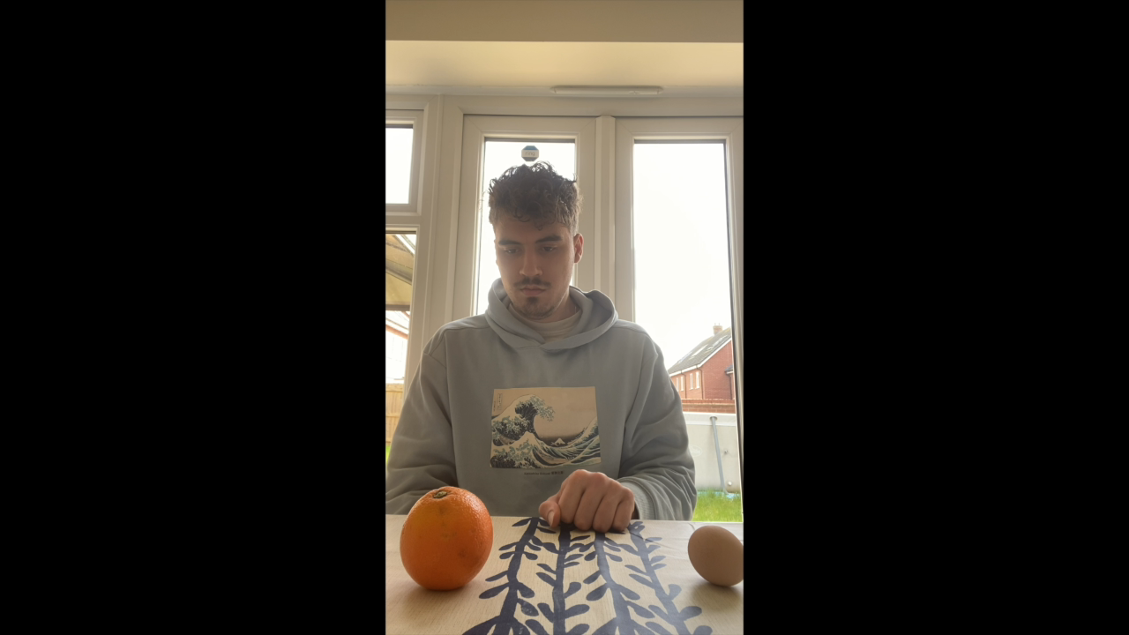
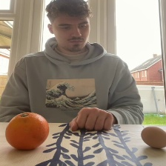
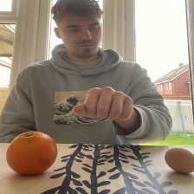
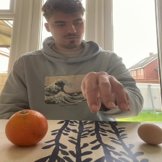
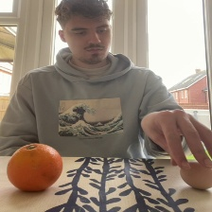
2) Description of Computational Model
Dataset Creation
I created 18 videos of me obtaining items on my left or right, this was then chopped into 50 key frames, for a total of 900 images for my dataset . Some preprocessing, image normalisation and resizing was done to allow input to the model.
Example Dataset Video
Right object goal, frames from video.

Slide 12
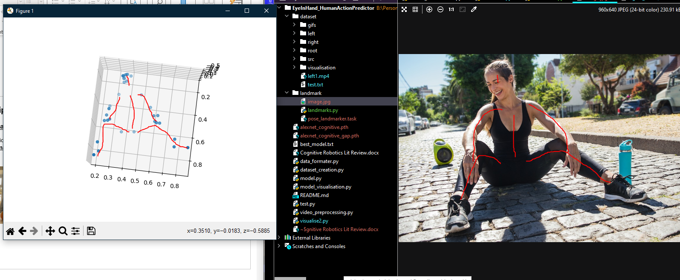
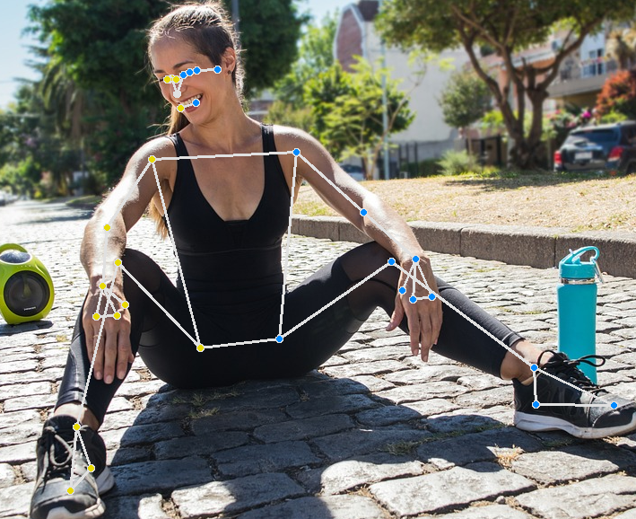
2) Description of Computational Model
Landmarks Based Computation
To better understand whether my model reliance on just visual cues was causing issues in terms of determining a goal, I wanted to see if knowing arm trajectory aided in the goal processes, and if this was useful in determining the goal, confirming the conclusion given.
Estimated
Landmarks based on 3D plot
3D Plot of the human model.
Landmarks found

Slide 13
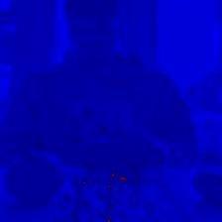
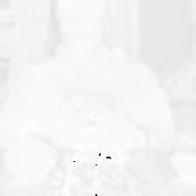
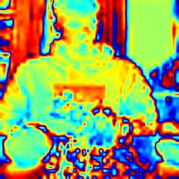
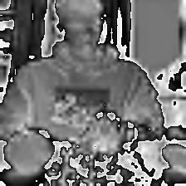
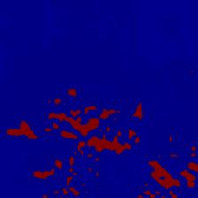
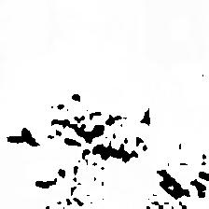
3) Results and Conclusion
Understanding Model Learning (3 Iterations)
Iteration 1) (Very noisy and not enough information) Low Level Initial Convolution Layers Feature Maps, shows the fundamental blocks of CNN recognition for goal, however not specifically showing useful information.
Frame 10
Frame 23
Frame 3
Fundamental kernels are highlighting the hand preshape for understanding the goal, like what is current mentioned in the paper.
Model overfits the data, with an image for associating goals to left objects, reliant on memorising image, model failure.
Model with initial frames relies on many random parts of jumper and body position to make assumption but not eyes.
Steps were taking in next iterations to stop this from occurring.

Slide 14
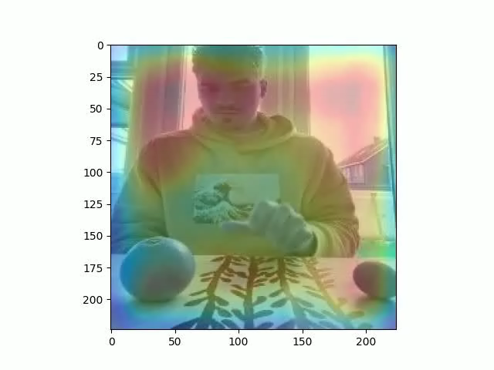
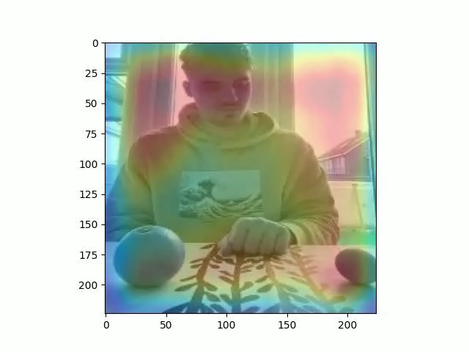
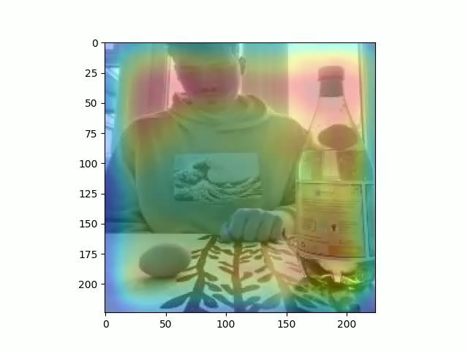
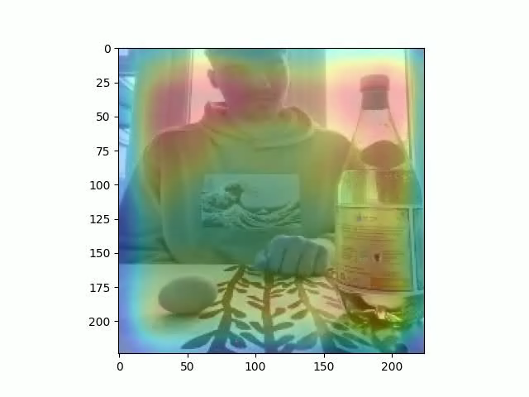
3) Results and Conclusion
Understanding Model Learning (3 Iterations)
Iteration 2) (Noisy Live Predictions) Combination of CNN outputs for last convolution, showing consensus of attention region when making decision (noisy and hard to understand.)

Slide 15
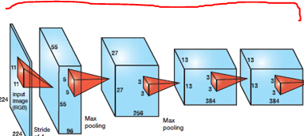
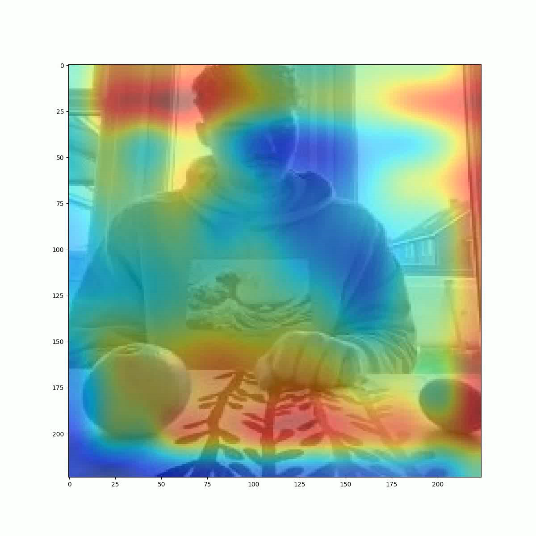
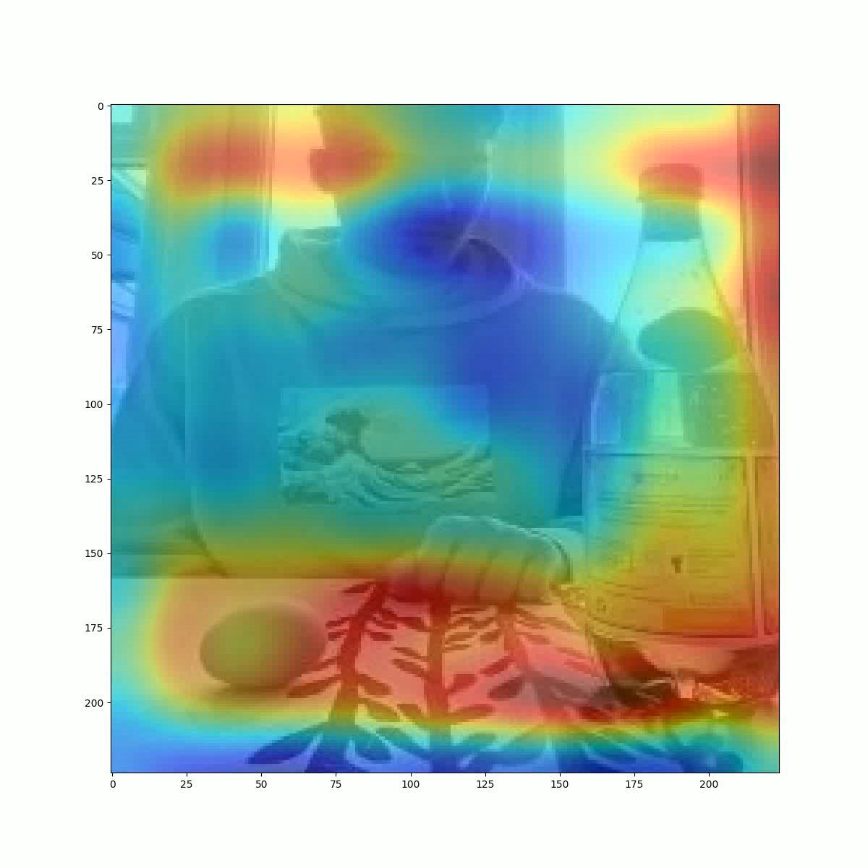
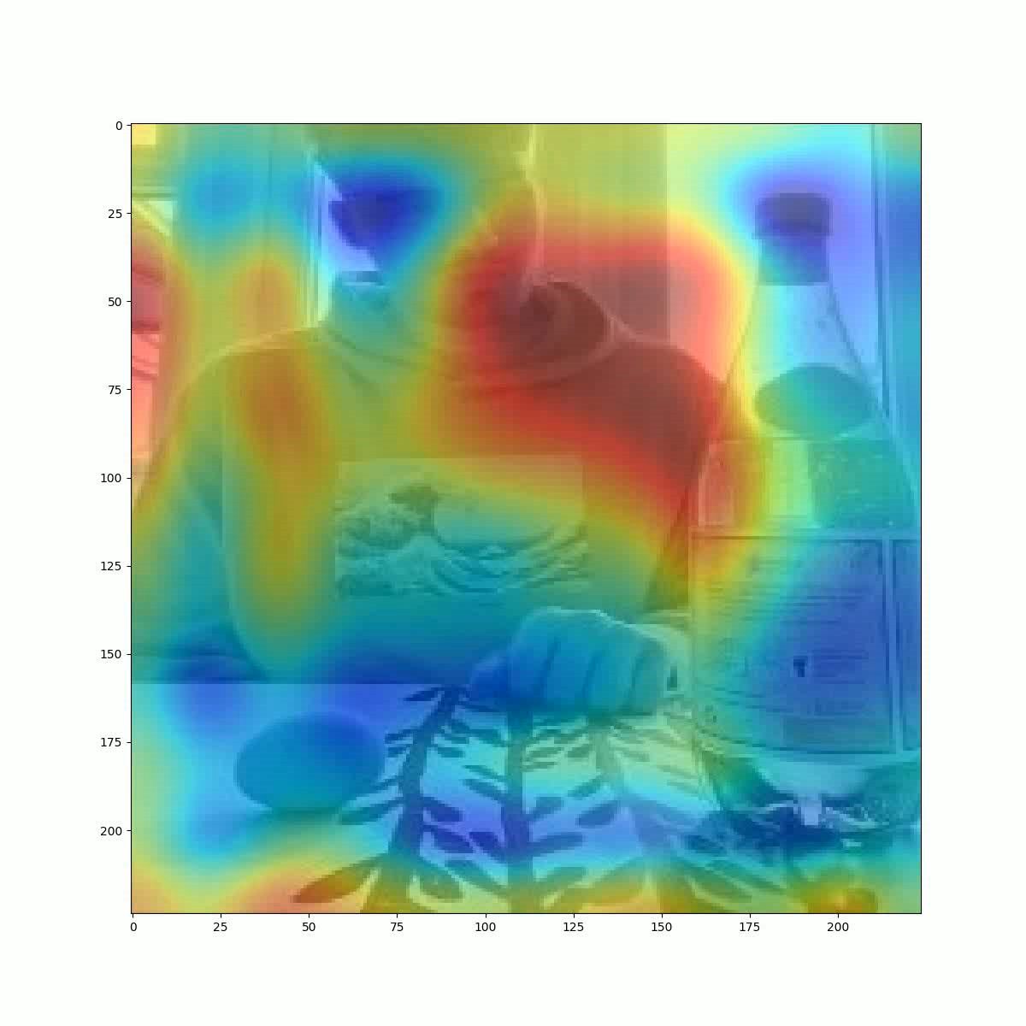
3) Results and Conclusion
Understanding Model Learning (3 Iterations)
Iteration 3) (Accurate Weighted Convolutions) These visualisation accurately simulate the complete convolutions the model performs and the strongest signals (blue signals).

Slide 16
3) Results and Conclusion
Deeper Understanding
First obtains key information from eyes to make inferences.
Second the attention goes to preshape and is continuous. Instant removal of attention from eyes when new information is available.
Closer to goal, all attention is moved to the bottom left, meaning overall confidence in goal increases.

Slide 17

3) Results and Conclusion
Problems with Paper
The paper does not handle issues including that say dependencies such as empty cup or water bottle, in which a goal may be decided based on context rather than imperial features.
Paper does not consider that participants, may perhaps remember specific scenes, such that a prediction becomes a remembering game rather than a completion.
As time progressed, participants relied more on arm movements such as arm trajectory.
Over time of the experiment, actor’s gaze was less reliantly used for accuracy, and was modulated by learning.
Gaze information is only able to effect predicted outcome only when no other information about intention is provided.

